Slide 1
Story Telling With Data

Slide 2
Outline
Why story telling with data matters?
What is data visualization?
Chart Types and when to use
Summary of charts and their purpose

Slide 3
Why story telling with data matters
Data visualization is transforming complex data into information which is easier to understand.
Data visualizations are created to answer “what” questions but the don’t explain the “why”, or provide contextual information to find the reason.
Data story telling links the visualization with a narrative to answer the “why” question, and conveys credible and compelling insights that is actionable by the decision makers.
Data story telling connects the visualization and the narration/insights to the audience to make data-driven decisions.
Dashboards are tools designed to consolidate data, track key metrics and facilitate data driven decision making.
Notes:
The narrative is the key vehicle to convey insights and the visualizations are important proof points to backup the narrative

Slide 4
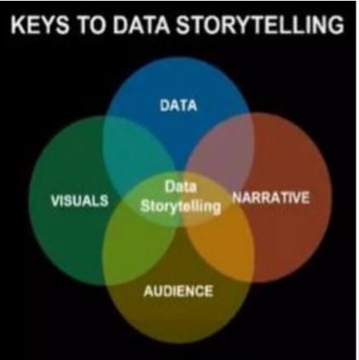
Keys to story telling with data

Slide 5
Steps of story telling with data
Identify your story
What questions are you trying to answer
Context/ current situation
Collect your data
What data will help you tell that story
What are you trying to achieve with the data
Be aware of your audience
Who is your target audience
What are the most important points you want to focus on
What level of data detail will they expect
Transform the data to data visualization
How you want to present the data: charts, graphs
Generate your insights/ Narration
Answer the ‘Why’ question of your visualization
What is the one thing you want your audience to know
Conclude with actions to take
Notes:
Establish an objective and story: What problem are you trying to solve,

Slide 6
Data Story Telling Design Framework
Define the purpose
Choose the right metrics
Present the data effectively
Eliminate clutter and noise
Use layout to focus attention
Tell a clear story
Notes:
Define the purpose – who is the audience , what are their goals and what specific questions do they need answers to.
Choose the right metrics – the data you present directly aligns with the business goals and the level of detail is appropriate for your audience.
Present the data effectively and select the right visuals for analysis
Eliminate clutter and noise – 3D formats, excessive color, background images , anything that takes up space and doesn’t add value or contribute to the story
Quote: Perfection is achieved not when there is nothing more to add but when there is nothing left to take away
Use layout to focus attention – group related elements on a page using use attributes like size & color to draw attention to specific patterns or data points and make sure your audience see the most important information first
Tell a clear story – descriptive charts titles and data labels can help you build a narrative.

Slide 7
Why is data visualization important
Data visualizations highlight patterns and trends in data and gives the reader quick insights
Data visualizations are easier to understand than text based narratives or numbers.

Slide 8
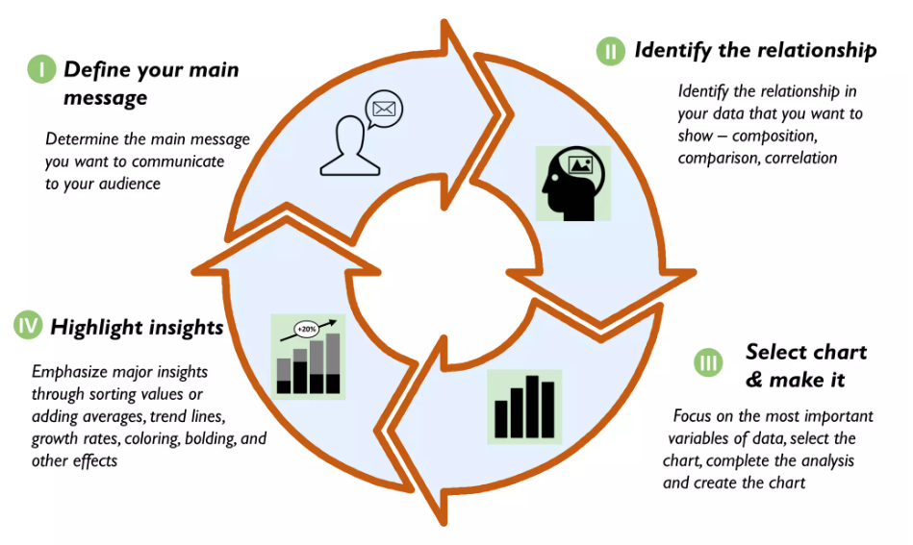
Principles of developing effective data visualizations

Slide 9
Chart types and when to use
Line chart
Bart chart
Stacked bar chart
Pie chart
Area chart
Scatter chart

Slide 10
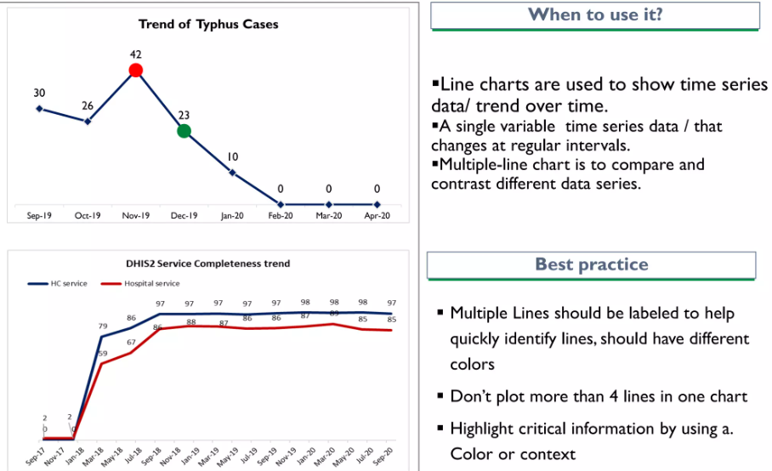
Line Chart

Slide 11
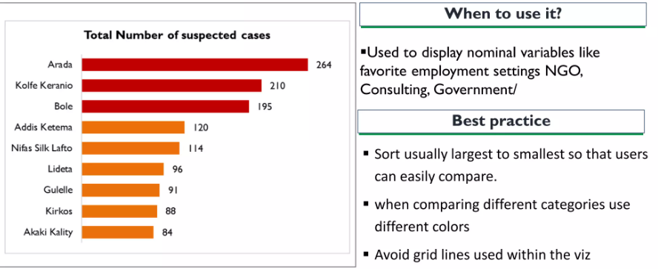
Bar Chart
Used to show comparison among categories
Do not use 3D format to avoid unnecessary noise
Horizontal Bar Chart

Slide 12
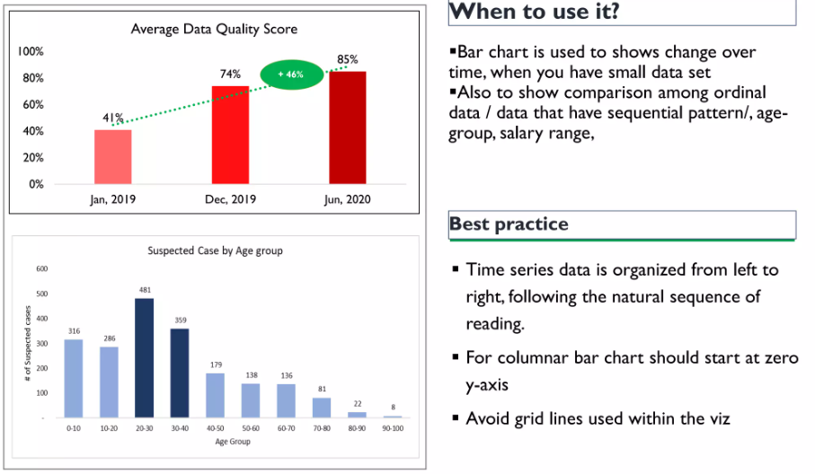
Vertical Bar Chart

Slide 13
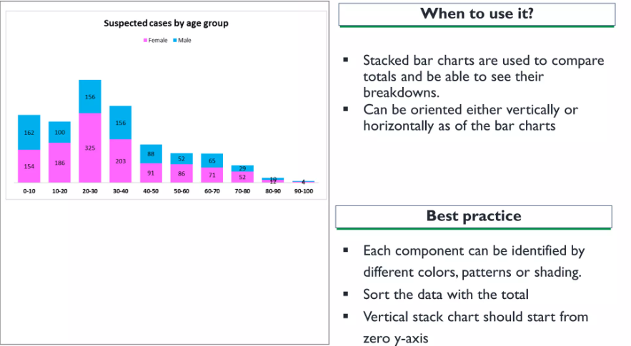
Stacked Bar Chart

Slide 14
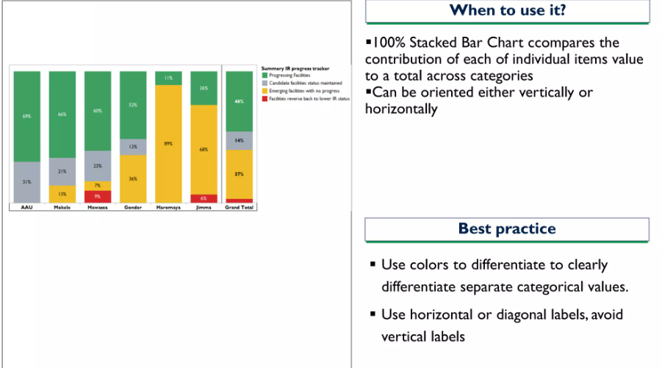
Fully Stacked Bar Chart

Slide 15
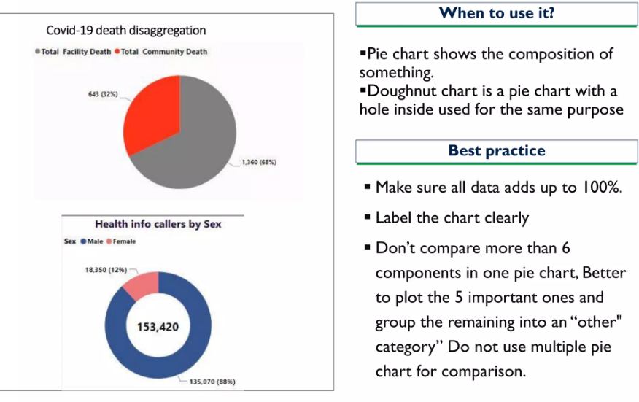
Pie and Donut Chart

Slide 16
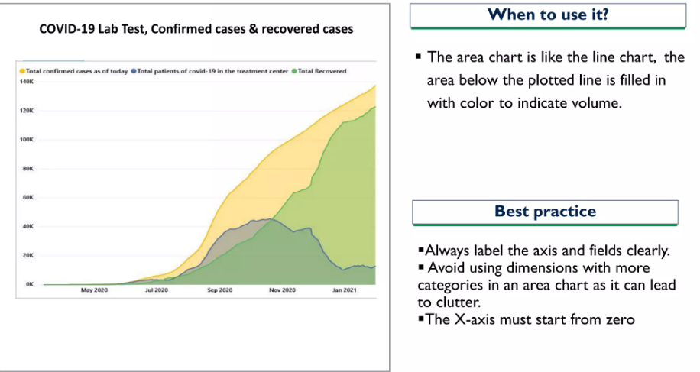
Area Chart

Slide 17
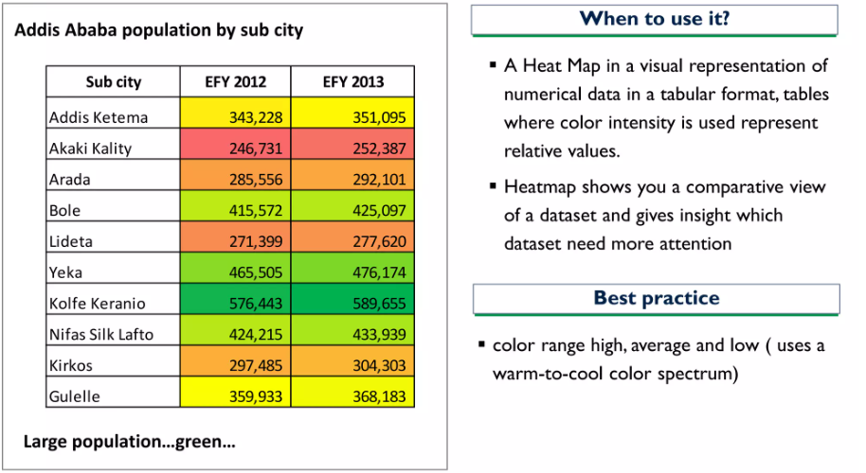
Heat Map

Slide 18
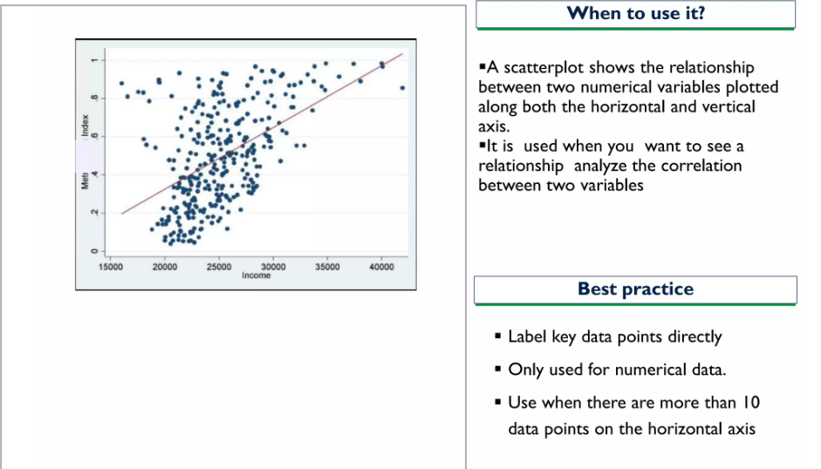
Scatter Plot

Slide 19
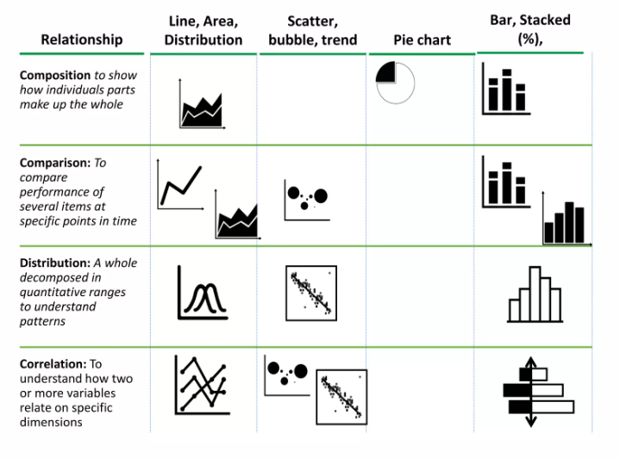
Summary of Quantitative data visualization

Slide 20
Univariate, Bivariate and Multivariate data and its analysis
Data analysis is an important process for understanding patterns and making informed decisions based on data.
Depending on the number of variables involved it can be classified into three main types: univariate, bivariate and multivariate analysis.
Each method focuses on different aspects of the data which provides a comprehensive understanding of its characteristics and relationships.

Slide 21

Univariate Data
Univariate data refers to a dataset where each observation is associated with only one variable.
It is the most straightforward type of statistical analysis as it finds only one variable at a time without considering relationships with other variables.
Example: Consider the heights (in cm) of seven students in a class.
Here the only variable is height and no relationship or interaction with other variables is being considered.

Slide 22
Key points in Univariate analysis
1. No Relationships: It focuses on describing and summarizing the distribution of a single variable.
2. Descriptive Statistics: Common techniques include:
Measures of Central Tendency: Measures such as mean, median and mode to represent the central value of the data.
Measures of Dispersion: Measures like range, variance and standard deviation to show the spread or variability of the data.
3. Visualization: Graphical methods like histograms, box plots and other visual tools are used to represent the distribution and overall pattern

Slide 23
Bivariate data
Bivariate data refers to a dataset where each observation is associated with two different variables.
The goal of analyzing bivariate data is to understand the relationship or association between these two variables.
It helps to identify how one variable might affect or be related to the other.
Example: Consider the relationship between temperature and ice cream sales during the summer season:

Slide 24
Key Points in Bivariate Analysis
1. Relationship Analysis: The primary goal of analyzing bivariate data is to understand the relationship between the two variables.
This relationship could be positive (both variables increase together), negative (one variable increases while the other decreases) or show no clear pattern.
2. Correlation: Quantifies the strength and direction of the relationship. It ranges from -1 to +1
3. Visualization: Tools like scatter plots help to visualize the relationship between the two variables.

Slide 25
Multivariate data
Multivariate data refers to datasets where each observation is associated with more than two variables.
This type of data analysis focuses on understanding the interactions and relationships among multiple variables simultaneously.
It is used when we want to see how multiple variables influence or relate to each other at the same time.
Example: Consider a scenario where an advertiser wants to analyze the click rates for different advertisements on a website. The data includes multiple variables such as advertisement type, gender and click rate.

Slide 26
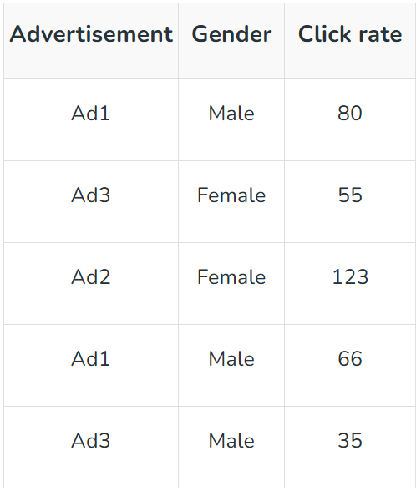
Multivariate Data Analysis
Here there are three variables: advertisement type, gender and click rate.
Multivariate analysis allows us to see how these variables interact and how one variable might affect another in the context of the others.

Slide 27
Key Points in Multivariate Analysis
Complex Relationships: Multivariate analysis helps to find patterns and relationships that are not obvious when looking at individual variables.
Analysis Techniques: Techniques such as regression analysis, principal component analysis (PCA) and multivariate analysis of variance (MANOVA) are used to understand interactions between multiple variables.
Interpretation: It provides a deeper and more nuanced understanding of the data which helps us to identify underlying factors that influence the observed patterns.

Slide 28
Real-World Applications
Univariate Analysis
Customer Behavior Studies: Analyzing a single variable like age or spending patterns helps businesses understand customer demographics and optimize marketing strategies.
Financial Reporting: It is used to track revenue or expenses over time to identify trends.
Bivariate Analysis:
Market Research: Analyzing the relationship between advertising spend and sales helps businesses optimize marketing efforts.
Customer Satisfaction: Exploring the link between product ratings and purchase frequency helps companies understand how satisfaction influences sales.

Slide 29
Real-World Applications
Multivariate Analysis:
Healthcare Predictive Modeling: Multivariate analysis helps predict patient outcomes based on factors like age, medical history and lifestyle.
Financial Risk Analysis: It’s used to assess investment risks by analyzing variables like interest rates, inflation and market conditions.

